Slide 1

Maryland’s Apprenticeship Training Fund Law
Ensuring quality training programs for the betterment of the merit construction industry.

Slide 2
how the law affects you
Do you work on Maryland state-funded projects exceeding $100,000?
If so, you must pay 25 cents per man-hour into an apprenticeship program for all workers on the project. Failure to comply means you’re liable for fines at twice the amount of unpaid apprenticeship training contributions and can open you up to civil penalties as well.
How do you comply AND select the right recipient?
When contractors are awarded a state-funded project, they will be required to register electronically with the DLLR. Once registered under the Certified Payroll Process, contractors will need to select the sponsor apprenticeship program to which they want to pay the required 25 cents per man-hour. We ask that you choose ABC.
abcmetrowashington.org/ChooseABC

Slide 3
why is sponsor selection important?
Unless you select a different recipient, the required 25 cents per man-hour contractors pay automatically goes to the Maryland state fund.
Selecting the Associated Builders and Contractors Craft Training Trust as your contribution recipient ensures funds received will be dedicated to providing quality training programs for the betterment of the merit construction industry.
abcmetrowashington.org/ChooseABC

Slide 4
how will abc use the money?
By selecting ABC Craft Training Trust as your recipient, we will use the funds to make critical improvements to our apprenticeship programs, including, but not limited to:
Enhancements to hands-on training laboratories, e.g., equipment, tools, materials and supplies
Support and training for instructional staff
Expansion of staff to include more trade specialists
abcmetrowashington.org/ChooseABC

Slide 5
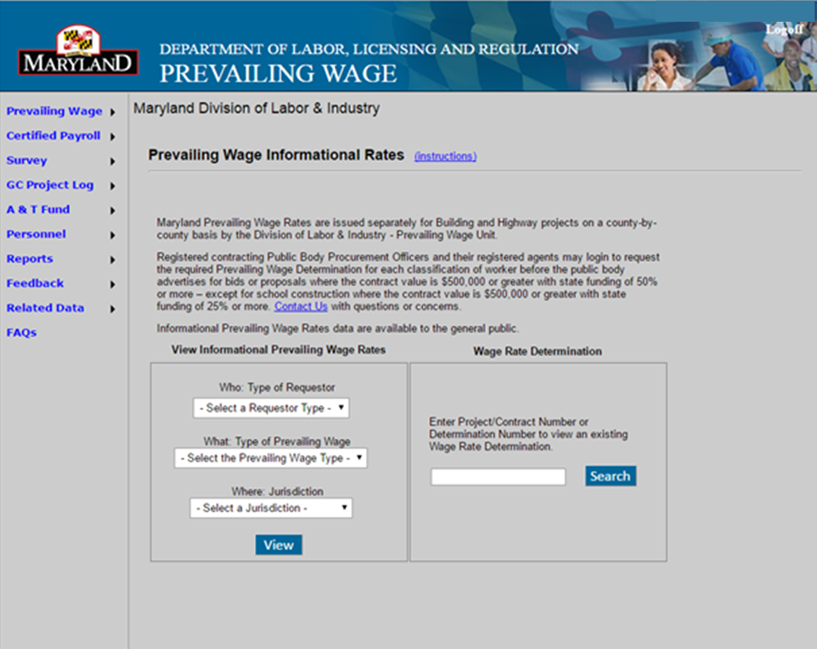

assigning a sponsor
The first week of certified payroll, you need to select your sponsor.
Login to DLLR and you’ll come to this page

Slide 6
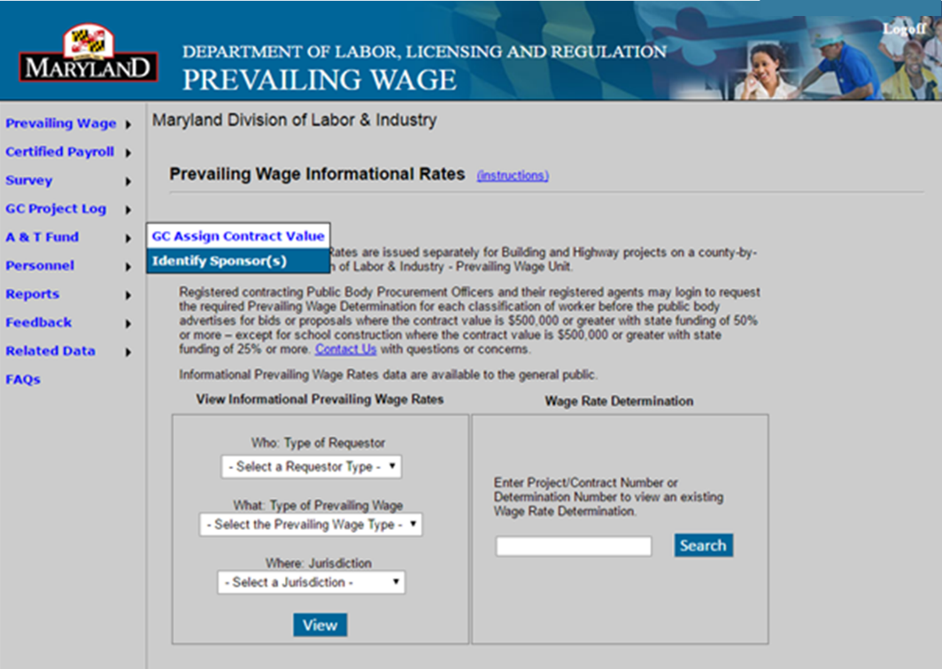

step 1
Hover over A&T Fund
Select Identify Sponsor

Slide 7
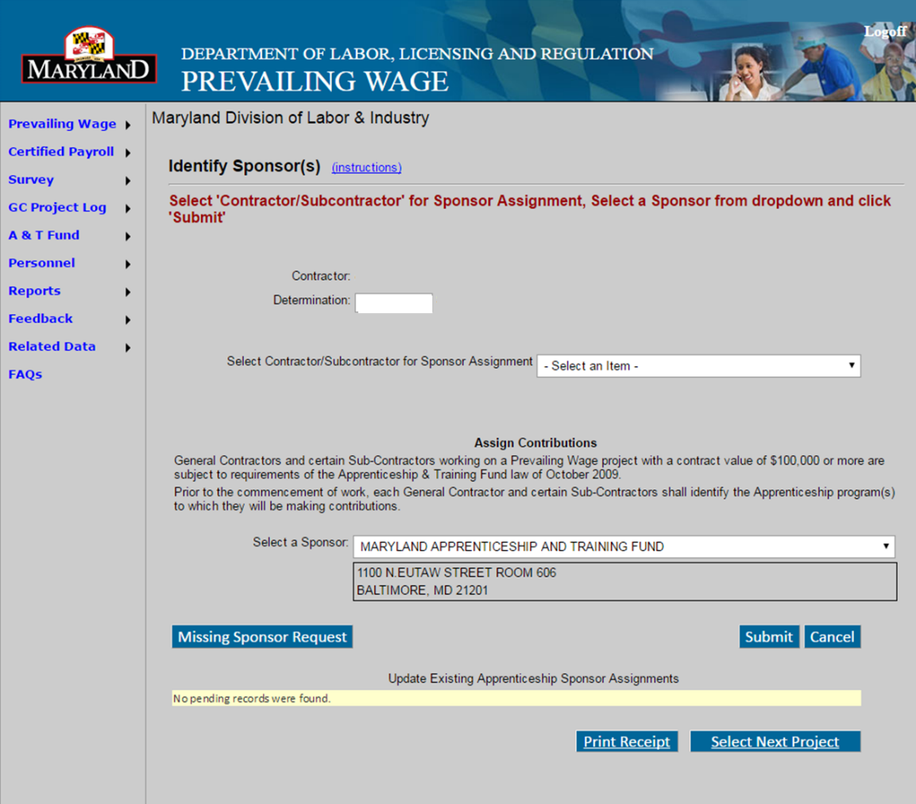
step 2
The sponsor automatically defaults to Maryland Apprenticeship Training Fund unless you click the pull down menu to select your choice.
Click the pull down menu arrow

Slide 8
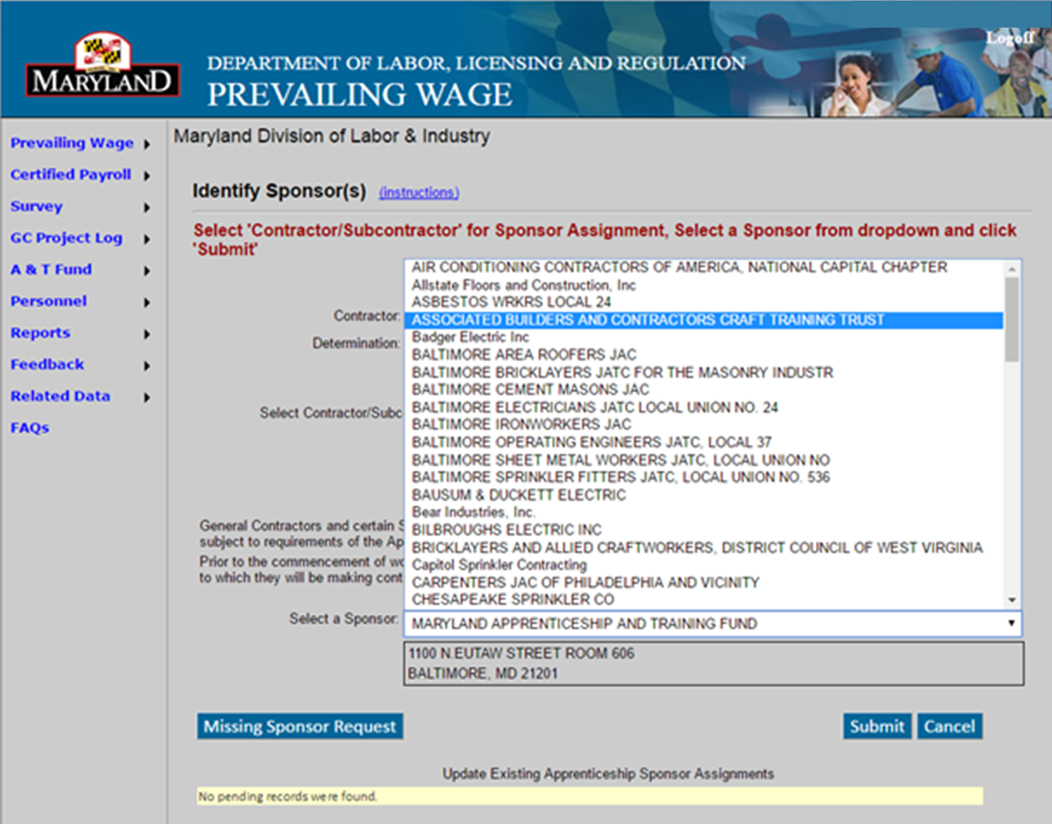
step 3
Scroll down until you find
ASSOCIATED BUILDERS AND CONTRACTORS CRAFT TRAINING TRUST and click it.
Submit

Slide 9
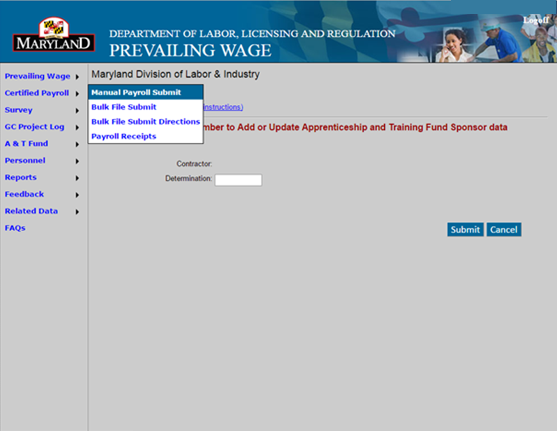
you’re finished!
Now you’re ready to process your payroll submission.

Slide 10
questions?
Jason Roberts
ABC of Metro Washington
jroberts@abcmetrowashington.org
301-595-9711
Thank you for choosing ABC!

